Slide 1


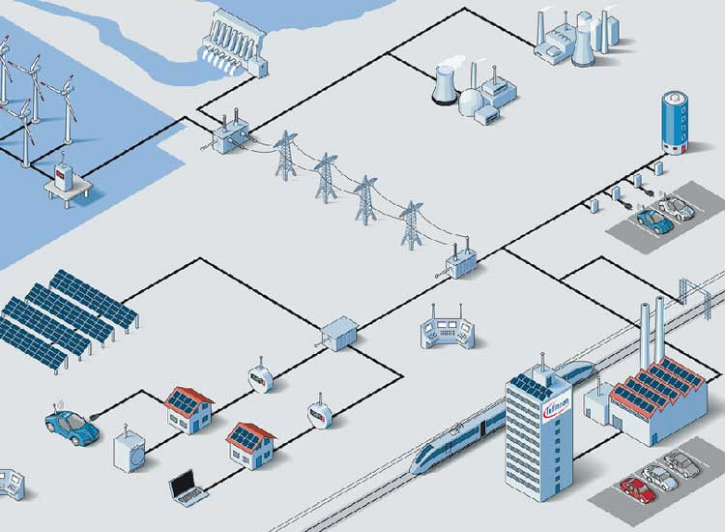

PROJECT AdaptVSG
EC601
Instructor Osama Alshaykh
By Anh Phung

Slide 2




Mission
For power engineers and researchers who need to maintain stable power system frequency in inverter-based distributed generators for microgrids working in islanded mode, the Adaptive Virtual Inertia VSG Controller is a simulation-based frequency stabilization system that dynamically adjusts virtual inertia in response to disturbances and improve frequency stability

Slide 3




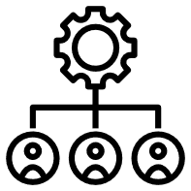

User Stories
Power Researchers
Simulate and compare different VSG controller to evaluate their frequency stability performance
Power/Control Engineers
Renewable Energy Developers
Adjust virtual inertia so that I can minimize the rate of change of frequency (RoCoF) and frequency deviations during disturbances
Evaluate adaptive VSG performance to determine its operability in a microgrid

Slide 4
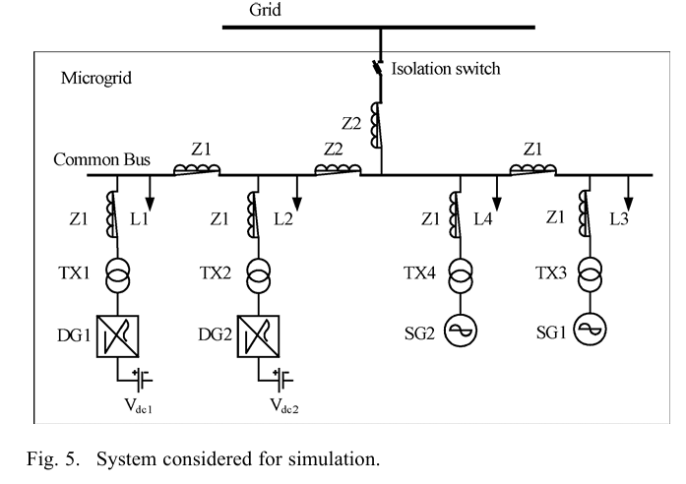



Tools
MATLAB/Simulink
Model and Simulate DERs system to examine its behavior
Simscape Electrical
Provides component libraries for modeling and simulating electronic, mechatronic, and electrical power systems.
Control System Toolbox
Provides algorithms and apps for systematically analyzing, designing, and tuning linear control systems

Slide 5

Progress
1
This paper introduce SVPP and tune their J and D parameters toward a target frequency response. Frequency nadir, and average RoCoF are important indicator
2
This paper gives a broad survey of both the challenges a low-inertia system face and review of current solutions
3
This paper addresses the voltage unbalance and lack of inertia when microgrid is in islanded mode.
4
This paper provide the basic operating principle and in-depth analysis of VSG and issues with VSG are also discussed

Slide 6


What I learned?
Plenty of Control Methods
So many control methods than I had expected with different grid configurations.

Slide 7

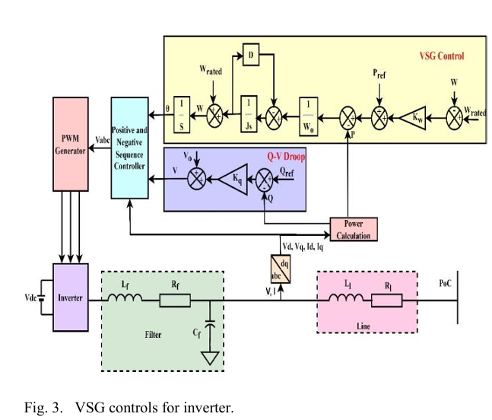
Sprint 2 Goals
Develop a working MATLAB/Simulink microgrid model with grid-forming inverter and implement conventional droop control, fixed VSG control as baseline.
Developing grid-forming inverter, droop control and VSG control

Slide 8



References
[1] Hu, Qinran & Rushuai, Han & Quan, Xiangjun & Wu, Zaijun & Tang, Chenghong & Li, Wei & Wang, Wei. (2022). Grid-Forming Inverter Enabled Virtual Power Plants With Inertia Support Capability. IEEE Transactions on Smart Grid. 13. 4134-4143. 10.1109/TSG.2022.3141414.
[2] Milano, Federico & Dörfler, Florian & Hug, Gabriela & Hill, David & Verbic, Gregor. (2018). Foundations and Challenges of Low-Inertia Systems. 10.23919/PSCC.2018.8450880.
[3] S. Sinha, N. Ali, D. Kumar and S. Anwar, "Virtual Synchronous Generator-Based Positive Negative Sequence Control Scheme for Voltage Unbalance Mitigation in Low Inertia Islanded Microgrid," 2024 1st International Conference on Innovative Sustainable Technologies for Energy, Mechatronics, and Smart Systems (ISTEMS), Dehradun, India, 2024, pp. 1-6, doi: 10.1109/ISTEMS60181.2024.10560182.
[4] Sang, W., Guo, W., Dai, S., Tian, C., Yu, S., & Teng, Y. (2022). Virtual Synchronous Generator, a Comprehensive Overview. Energies, 15(17), 6148. https://doi.org/10.3390/en15176148

